Slide 1
Precise Cooling Temperature Control Ensures Quality and Increased Cycle Counts
Bert Wesley, P.E., Woodard & Curran
Keynote Speaker
The recording and slides of this webinar will be made available to attendees via email within later today
PDH Certificates will be e-mailed to attendees within 2 days.

Slide 2
Q&A Format
Panelists will answer your questions during the Q&A session at the end of the Webinar.
Please post your questions in the Questions Window in your GoToWebinar interface.
Direct all questions to Chiller & Cooling Best Practices® Magazine

Slide 3
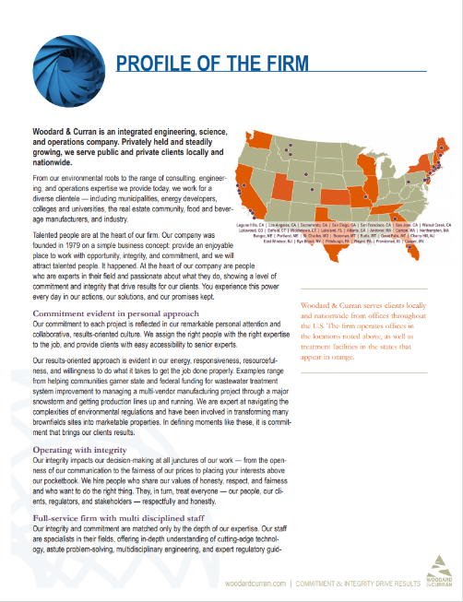
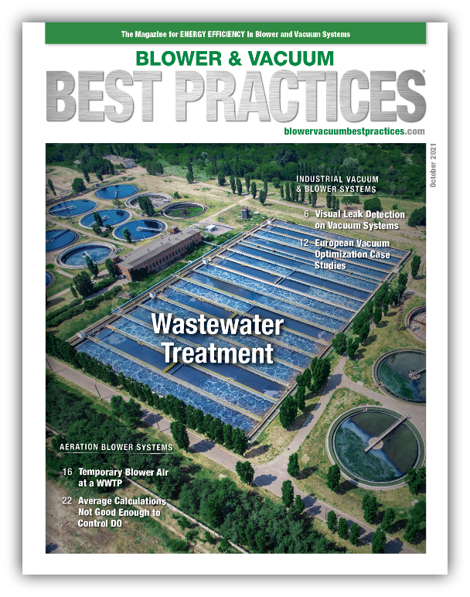
Handouts

Slide 4
Disclaimer
All rights are reserved. The contents of this publication may not be reproduced in whole or in part without consent of Smith Onandia Communications LLC. Smith Onandia Communications LLC does not assume and hereby disclaims any liability to any person for any loss or damage caused by errors or omissions in the material contained herein, regardless of whether such errors result from negligence, accident, or any other cause whatsoever.
All materials presented are educational. Each system is unique and must be evaluated on its own merits.

Slide 6
Precise Cooling Temperature Control Ensures Quality and Increased Cycle Counts
Introduction
Chiller & Cooling Best Practices® Magazine

Slide 7
About the Speaker
Sr. Principal, Industrial Plant Engineering Practice Leader Woodard & Curran
30 years in heavy industry
Deliver utility applications tailored to manufacturing equipment
Bert Wesley, P.E.
Woodard & Curran

Slide 8
Presentation Particulars
Discussion today will use general numbers that are close but not exact for ease of discussion
Not an advertisement for any product or service
Many ways to accomplish the goal
Keep open mind
Some items were changed at the request of the client

Slide 9
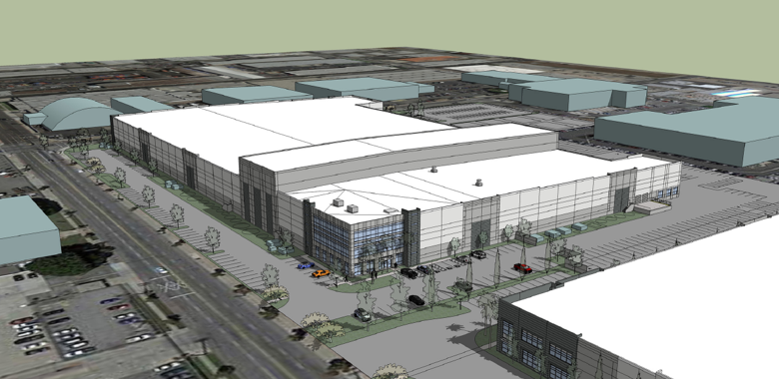
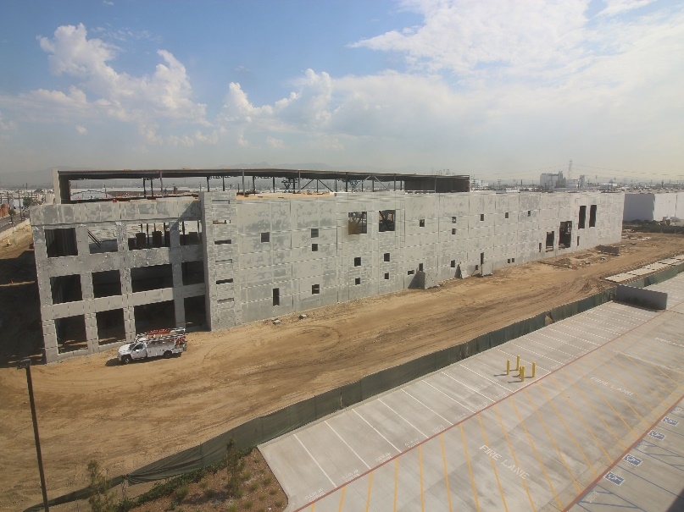
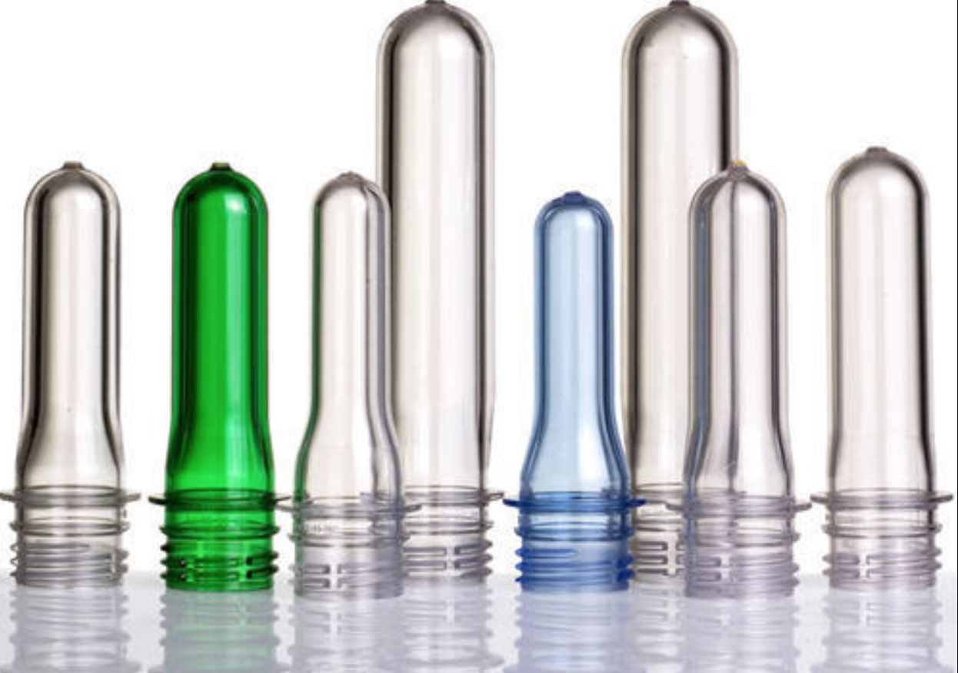
Client – rPlanet Earth, Vernon, CA

Slide 10
High Speed Manufacturing Equipment has Exacting Requirements
How do we design for multiple users and varying requirements?
Single looped system for all users
Maintain loop pressure
5 Injection Molders
7 Sheet Lines
2 Thermoformers

Slide 11
Design Considerations – Chilled Water
Injection Molder 345 GPM at 45 psi
Sheet Line 254 GPM at 52 psi
Thermoformer 123 GPM at 55 psi
If these conditions are not met, the equipment can fault out
Three design points:
Zero – what happens when there’s no call for cooling water
Steady state – Normal operation of the equipment
Infinity – All production lines call for cooling water simultaneously

Slide 12
Sheet Extrusion Line

Slide 13
Thermoformer

Slide 14
Chiller Plant Design – Old ways
Primary/ Secondary
Many Pumps – constant fluid circulation regardless of process load
Hot tank/Cold tank – buffer capacity – large volume 20,000 gallons each
Large capital investment
Large footprint
Large energy demand not necessarily tied to production schedule
Definitely works. Can we do it more efficiently?

Slide 15
Chiller Plant Design Newer
Variable Primary (Variable Speed Pump)
Recirculation valves to keep the header at target temperature
Combination hot/cold tank
Much lower volume due to lack of space for the tank(s)

Slide 16
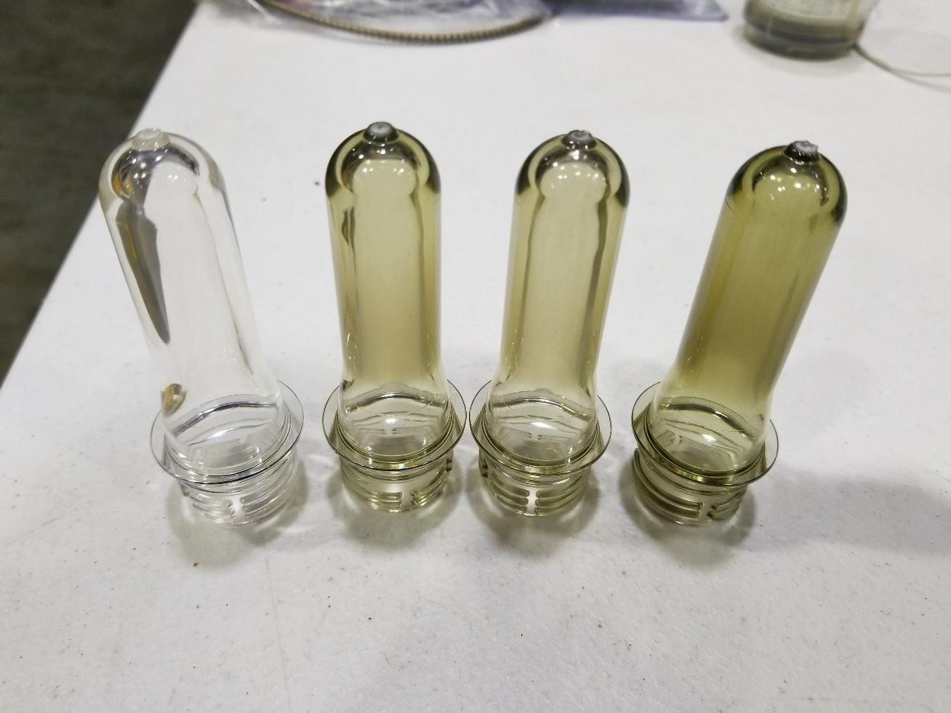
Husky Injection Molder

Slide 17
Simple System Schematic

Slide 18
Chilled Water Equipment
Centrifugal Chiller
Model: CVHF0570
Capacity: 600 Tons
Centrifugal water-cooled chiller has two shell-and-tube heat exchangers; the evaporator (low pressure) and condenser (high pressure) sides and a compressor

Slide 19
Chiller P&ID

Slide 20
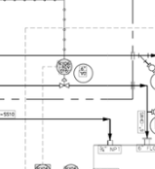
Hot/Cold Tank 2500 Gal

Slide 21
Design Innovation
Added flow meter to the chilled water supply line to manufacturing
Added flow meter to the tank bypass line
Numerous temperature transmitters throughout the piping network
Solenoids open to allow chilled water flow as temperature in the supply pipe warms up

Slide 22
Enhanced Flow Management Package
Trane Chiller Enhanced Flow Management Package
Uses a variable water-flow compensation algorithm
Published data claims temperature control at a change in water flow rate of 30% per minute
Field actual performance controls temperature to water flow rate of 50% per minute
Any additional water the chiller can chill is routed to the hot/cold tank via the control valve
As flow rate increases to the production equipment, the chiller can chill more water than the production equipment requires (in most scenarios), and the residual water is diverted back to the hot tank, to prechill the incoming hot water from the production equipment.

Slide 23
Flow Change with EFMP

Slide 24
Flow Change without EFMP

Slide 25
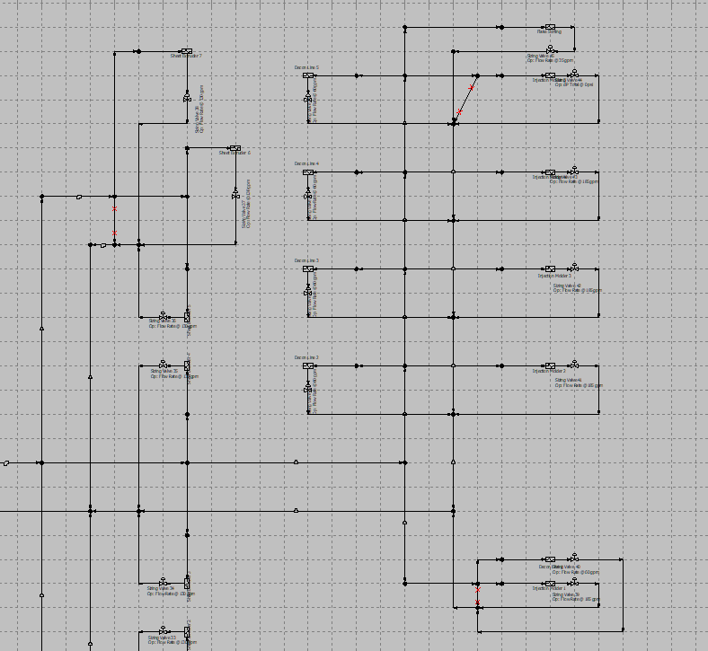
Innovation Solutions
Calculated using several flow model software packages
Design collaboration with Trane Chiller Design Engineers
Trip to La Crosse, WI for design application meeting

Slide 26
Quick Reference Screen

Slide 27
Chiller & Tank Control Screen

Slide 28
Results
Production machine cycle time lowered from 17 seconds per cycle to 13 seconds per cycle.
30% Increase in Production!!!
211 cycles/hour * 100 preforms = 210,000 preforms (at 17 seconds)
276 cycles/hour * 100 preforms = 276,000 preforms (at 13 seconds)

Slide 29
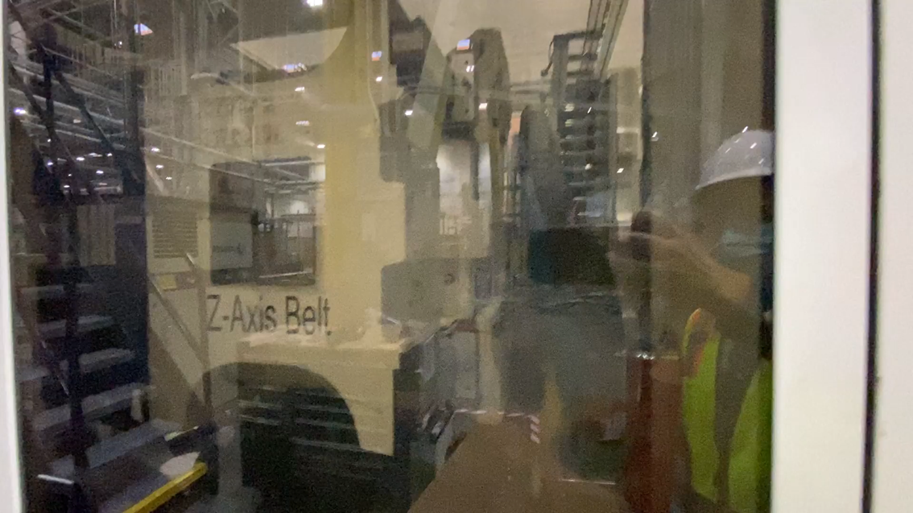
Machine Cycle

Slide 30
Key Learnings
Exact Temperature Control is possible given today’s components
Many decisions are needed to ensure optimal success
Embrace new ideas and techniques after proper vetting

Slide 31
Precise Cooling Temperature Control Ensures Quality and Increased Cycle Counts
Q&A
Please submit any questions through the Question Window on your GoToWebinar interface, directing them to Chiller & Cooling Best Practices Magazine. Our panelists will do their best to address your questions and will follow up with you on anything that goes unanswered during this session.
Thank you for attending!

Slide 32
Thank you for attending!
The recording and slides of this webinar will be made available to attendees via email later today.
PDH Certificates will be e-mailed to Attendees within 2 days.

Slide 33
December 2021 Webinar Measuring KPI’s for Efficiency: kW, Flow and Pressure
Sponsored by
Tim Dugan
Compression Engineering Corporation
Keynote Speaker
Thursday, December 16, 2021 – 2:00 PM EST
Register for free at
www.airbestpractices.com/magazine/webinars

